Slide 1

PGPDM 2018-19 Capstone Project
By
Prasad Patole, Anil Nair, Hiran Kumar, K Maadhu, Kedar Sapte & Surbhi Shrivastav

Slide 2
About the Project
The objective of this project is to provide a qualitative analysis for the various tourist attractions in India based on user review comments.
To have a collective representation of the attractions, the categories of beaches, heritages and hill stations were chosen.
Attraction information and user review comments for the above three categories was extracted from Trip Advisor and HolidayIQ websites and used as the data source.
The attraction review comments were analyzed based on the aspects given below:
Beach – Activity, Cleanliness, Food & View.
Heritage - Architecture, Art, Culture, History & Religion.
Hill station – Activity, Climate, Landscape & View.
The sentiment score of the attractions based on each of the user review comments and the polarity score for the aforesaid aspects was generated.
The attractions were plotted in a Tableau map along with the above generated scores.

Slide 3
Data Extraction, Clean-up and Pre-processing
Data extraction was done through web scraping using the following packages
Trip Advisor
Python packages - BeautifulSoup, Selenium
HolidayIQ
Scrapy class with XPath selector and JSON.
The output files are:
- CSV file with ~10K attractions information along with description for each attraction.
- CSV file with ~200K user review comments for all the above attractions.
Clean-up and pre-processing
Data cleansing activity was performed on all the Attraction Descriptions and User Review Comments to remove non-ASCII values and special characters.
A public Geo-Coding API was used to get the Address and Lat/Long information for each of the attractions which was used for geo-spatial visualization.

Slide 4
Data Analysis
Sentiment Analysis
Sentiment Analysis using Vader Sentiment Intensity Analyser was performed on each of the review comments and an overall normalized sentiment score for each attraction was calculated.
Aspect Based Sentiment Analysis (ABSA)
For each category of attractions, the below aspects were identified based on the Bag of Words(BoW) frequency distribution from the attraction descriptions.
Beach – Activity, Cleanliness, Food & View.
Heritage - Architecture, Art, Culture, History & Religion.
Hill station – Activity, Climate, Landscape & View.
Using CoreNLP the review comments were parsed and its synonyms to the aspects were identified.
The polarity scores for each of the synonyms was aggregated at an attraction level.

Slide 5
Aspect based sentiment analysis - Methodology
User Review comments dump
Sentence dump file
- Tokenized words
- Part of Speech tags
- Word dependencies with POS tags
Aspect term identification
- List of aspect terms for each sentence
Sentiment polarity for each aspect word
Aspect term to attribute mapping
Stanford CoreNLP
Spacy
Rule based
Attribute to Sentiment polarity mapping
Activity: Positive
View: Negative
Landscape : Neutral
Diving: Positive
Sunset: Negative
Waterfall :Neutral
Sentiword
Senticnet
Diving: activity
Sunset: view
Waterfall: landscape
Wordnet synsets
Heritage_attributes = 'history’, 'architecture’, ’religion’, 'culture’, 'art’
Beach_attributes = 'cleanliness', 'view’, 'activity’, 'food’
Hill_station_attributes = 'view’, 'landscape’, 'activity’, 'climate'

Slide 6
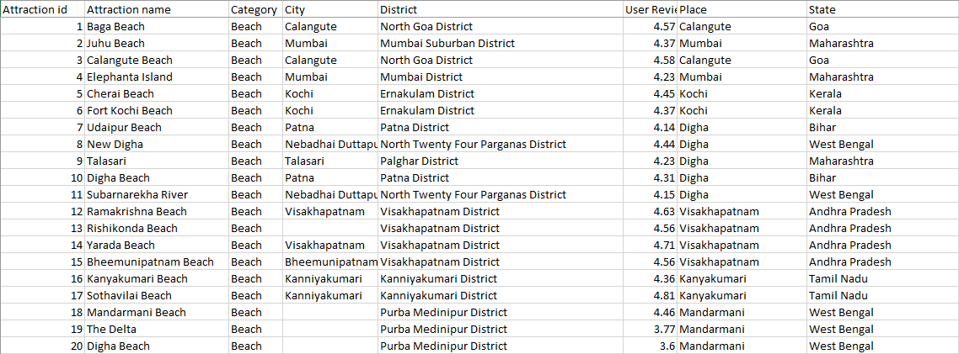
Attraction-wise Vader Sentiment score

Slide 7
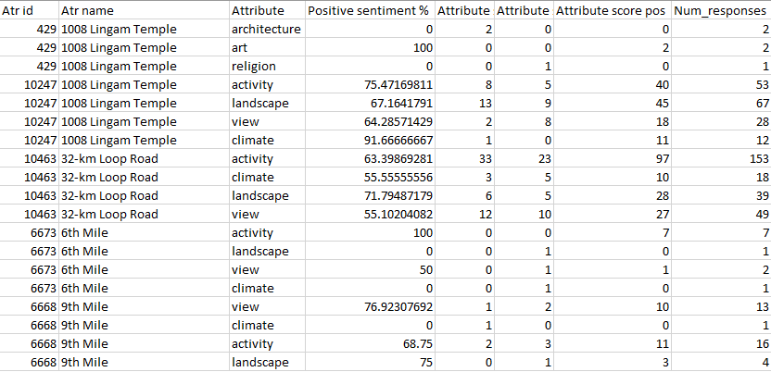
Attractions with Aspect Based Sentiment Score

Slide 8
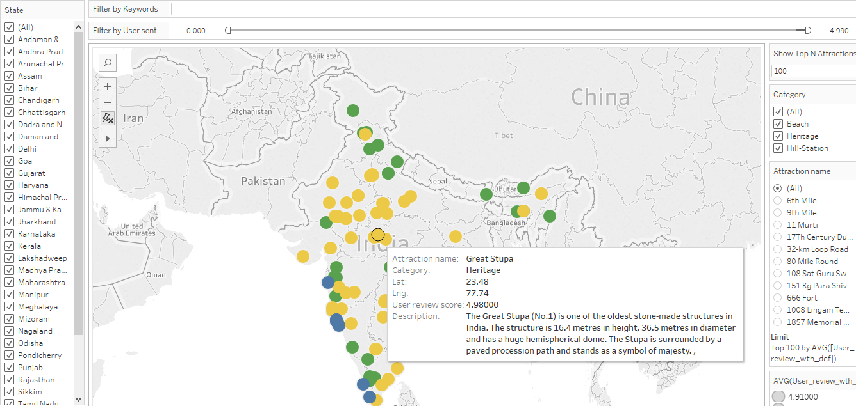
Top 100 attractions ranked by user sentiment score

Slide 9
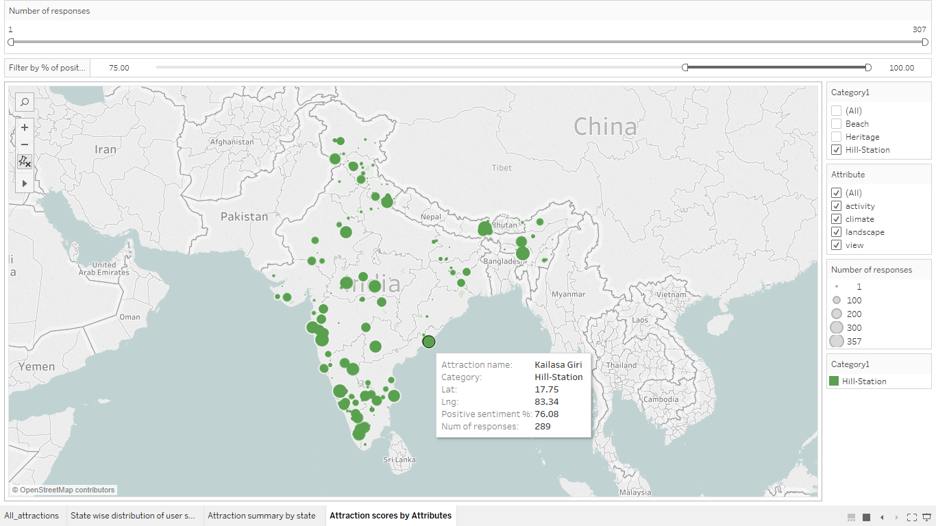
Hill Stations with ABSA score greater than 75%

Slide 10
Insights and Tableau Visualization
The sentiments and polarity scores help us in understanding each attraction based on the overall and aspects based sentiments.
This will provide us insights on each attraction in terms of these aspects.
The visualizations enables viewing attractions along with the review sentiment scores.
We can also view the attractions based on the aspects and its synonyms.
Link:
https://public.tableau.com/profile/hiran.kumar#!/vizhome/Capstone_visualizations_consolidated_0/All_attractions?publish=yes

Slide 11
Recommendations and Caveats
Recommendations
The project used data extracted from 2 websites, namely, Trip Advisor and HolidayIQ. It is recommended to extract data from more websites to improve the list of attractions and the sentiment score generated from its review comments.
Spacy NLP package can be used instead of CoreNLP for better performance as Spacy is native Python.
Word2vec can be used in place of WordNet to represent word meaning by its surrounding context with a vector.
IndoWordNet package can be used along with Senticnet to accommodate regional languages.
Instead of synonym set mapping, labelling of data and generating a model to classify the comments into appropriate aspects can lead to better accuracy.
Usage of Scrapy over BeautifulSoup yielded better performance for data extraction.
Caveats
Usage of vernacular phrases leads to duplicity and incorrect categorizations of words into aspects.
Usage of public Geo-Coding API did not provide accurate address and Lat/Long info for all attractions.
Vader sentiment analyser cannot be customised.
For aspect based sentiment analysis, it is assumed that the user review comments adhered to English grammatical syntax.

Slide 12


